Slide 1
Career Opportunities For Computer Graduates
BCA,B.Sc(Comp.Sc.),B.Sc(CAV)

Slide 2
Jobs in Private Sector
e.g. : Software Company, Web Designing.
Job in Government
Sector e.g. : Banking, Dairy ,Farming
Industries etc.
Create Own
Software Companies
Computer Graduate
Pursuing
Higher Study

Slide 3
Higher Studies Guide

Slide 4
Higher Studies After Graduation in Computers
Master of
Computer
Application
(MCA)
M.Sc.
Computer
Science
Master of
Information
Technology
(MSc IT)
Masters of
Information
Management
(MIM)
PGDCA/
PGDM
Masters in Business Administration
(MBA IT)

Slide 5
Courses after BCA, B.Sc (CS), B.sc(CAV)
Master of Computer Application (MCA)
Masters in Computer Science (M.Sc CS)
Masters in Computer Management (MCM)
Masters of Information Management (MIM)
Masters in Business Administration (MBA)
Postgraduate Diploma in Computer Applications
Postgraduate Diploma in Management
Master of Science in Information Technology (M.Sc IT)
Programme in Information Security Management

Slide 6
Other courses
Masters in Digital Business Management
Post graduate Programme in Software Enterprise Management
Masters in Computer Science-Information Systems Management
2-year Master in Management in Virtual Environment
Masters in E-Commerce
Masters in Mobile Business: Technologies And Mobile Marketing Apps
Masters in Internet Strategy and Web Management…

Slide 7
Courses Details

Slide 8
Courses | Eligibility Criteria | Type | Fees | Duration
MCA | Aspirants who have done Graduation in any discipline(Science,Commerce,Arts,Engineering) Students must have studied mathematics in 10+2 or any one year at graduation level Students need to write an entrance exam as to get admission into the MCA course. | Degree | 75,000INR to 90,000 INR in Govt. aided Institute 2 lakh INR -8 lakh INR in privately owned universities | 3 years
M.Sc CS | Candidate must have Bachelor’s degree in computer science / BCA/ B.Sc(IT) or equivalent from any recognized institute with 50% of marks or above | Degree | 20,000 INR to 50,000 INR in Govt. aided Institute 2 lakh INR -3 lakh INR in privately owned universities | 2 years

Slide 9
Courses | Eligibility Criteria | Type | Fees | Duration
M.Sc IT | Candidate must have Bachelor’s degree in computer science /B.Sc(IT)/BE/BCA/B.Sc(Electronics) with 45% to 50 % of marks | Degree | 1 Lakh INR to 5 Lakh INR | 2 years
MBA(IT) | Graduation in any discipline | Degree | 4 Lakh INR to 20 Lakh INR | 2 years
PGDCA | Graduation in any discipline with 50% marks | Diploma | 15000 INR to 50000 INR | 1 year

Slide 10
Courses | Eligibility Criteria | Type | Fees | Duration
PGDM | Graduation in any discipline with 50% marks | Diploma | 1 lakh INR – 5 lakh INR | 2 years
M.Sc (Animation) (specialized course) | Graduate in any stream or equivalent recognized degree with good sketching and drawing skills | Degree | 20,000 INR to 30,000 INR in Govt. aided Institute 2 lakh INR -8 lakh INR in privately owned universities | 2 years

Slide 11
Courses | Eligibility Criteria | Type | Fees | Duration
MIM | Graduation in any discipline with 50% marks | Degree | 1,00,000 INR -5,00,000 INR | 2 years
MCM | Graduation in any discipline with 50% marks | Degree | 1,00,000 INR -5,00,000 INR | 2 years

Slide 12
Admission Criteria for various courses

Slide 13
MCA
* Aspirants applied for MCA programme must qualified the Entrance Exam.Many leading Universities and Colleges conducted MCA entrance test ,some of them are:
MCA Entrance Exam | Syllabus | How To Apply
AIMCET (National level) | Computer Awareness, General Awareness Logical Reasoning and Analytical Reasoning, Mathematics | Candidates can apply for AIMCET via online as well as offline mode At http://www.iitr.ac.in Application forms are available in January or February
BITS MCA | Mathematics , Analytical Ability & Logical Reasoning ,Computer Awareness General English | Candidates should apply through Online
IPU CET MCA | ------do-------- | Candidates should apply through Online

Slide 14
JNU MCA | Mathematics and probability, Analytical Ability & Logical Reasoning ,Computer Awareness General Aptitude | http://www.jnu.ac.in/ http://www.jnu.ac.in/scss/mca-admission.html
NIT MCA (NIMCET | Mathematics , Analytical Ability & Logical Reasoning ,Computer Awareness General English | http://nimcet2016.nitdgp.ac.in
Thapar University | Mathematics , Analytical Ability & Logical Reasoning ,communication skills and GK | http://www.thapar.edu/
KU MCA | Mathematics , Analytical Ability & Logical Reasoning ,Computer Awareness English comprehension | www.kuk.ac.in
PU MCA | Mental and Numerical ability, GK, General English , Mathematics , Computer Awareness | http://pupadmissions.ac.in
IGNOU (Distance Education | Any Bachelor’s degree of minimum 3(three) year duration from a recognized University” AND “Mathematics as one of the subject at 10+2 level or graduation level; | http://www.ignou.ac.in/

Slide 15
M.Sc (Computer Science)
* Entrance test held depending upon university or college. Also some colleges offer direct enrollment on merit basis. Best Universities to apply:
Institute | Location | Website
Delhi University | Delhi | www.du.ac.in
Loyola College | Chennai | www.loyolacollege.edu/
Christ University | Bangalore | www.christuniversity.in/
Fregusson College | Pune | www.fergusson.edu/
St. Xavier’s College | Kolkata | www.sxccal.edu/
St. Francis College for Women | Hyderabad | www.sfc.ac.in/
The New College | Chennai | www.thenewcollege.in/
Barkatullah University | Bhopal | www.bubhopal.nic.in/

Slide 16
M.Sc (Information Technology)
* Entrance test held depending upon university or college. Also some colleges offer direct enrollment on merit basis. Best Universities to apply:
Institute | Location | Website
KCG College of Technology | Chennai | www.kcgcollege.ac.in/
DAICC | Thane | www.daicc.com/
University Institute of Science and Technology | Punjab | www.uiet.puchd.ac.in/
Babasaheb Bhimrao Ambedkar University | Luckhnow | www.bbau.ac.in/
Bishamber Sahai Degree College | Roorkee | http://www.bsigrouprke.com/
Brainware School of Information Technology | Kolkata | www.brainware-india.com/
Anna University : College of Engineering | Chennai | www.ceg.annauniv.edu/
AISECT University | Bhopal | www.aisectuniversity.ac.in/

Slide 17
M.B.A (Information Technology)
M.B.A Entrance Exam | Syllabus | How To Apply
MAT is conducted by (CMS) division of All India Management Association (AIMA). | Language Comprehension, Mathematical Skills, Data Analysis, Intelligence & Critical Reasoning, Indian & Global Environment | It is conducted 4 times a year: February,May ,September ,December www.aima-ind.org
CAT | Quantitative Ability, Data Interpretation & Logical Reasoning , Verbal & Reading Comprehension , GK | It is the most popular MBA entrance test and is held annually. www.iimcat.ac.in
SNAP(SYMBIOSIS NATIONAL APTITUDE TEST) | General English ,Quantitative Data Interpretation & Data Sufficiency, General Awareness: General Analytical & Logical Reasoning ,Current Affairs, Business Scenario | www.snaptest.org

Slide 18
Postgraduate Diploma In Computer Application)
Aspirants must be a Graduate in any discipline from a recognized Institute.
Colleges offer direct enrollment on merit basis.
Admission criteria varies from institute to institute

Slide 19
MCM (Masters in Computer Management)
* Most of the institutions carry out their own entrance exam for the admission process. Candidates with relevant score in CAT / MAT / XAT / ATMA / CET, etc are exempted from such admission tests
MCM Entrance Exam | Syllabus | How To Apply
CAT | Quantitative Ability, Data Interpretation & Logical Reasoning , Verbal & Reading Comprehension , GK | It is the most popular Management entrance test and is held annually. www.iimcat.ac.in
MAT | Language Comprehension, Mathematical Skills, Data Analysis, Intelligence & Critical Reasoning, Indian & Global Environment | It is conducted 4 times a year: February,May ,September ,December www.aima-ind.org
ATMA | Quantitative Ability, Analytic Skills , Verbal & Reading Comprehension | www.atmaaims.com/
XAT | Quantitative Ability, Decision Makin , Verbal & Reading Comprehension ,Essay Writing,GK | www.xatonline.net.in/

Slide 20
Masters of Information Management (MIM)
Most of the institutions carry out their own entrance exam for the admission process. Candidates with relevant score in CAT / MAT / XAT / ATMA / CET, etc are exempted from such admission tests
The admission notification for the course will be made available through the web portal of the institute or the University that offers the particular course
MIM Entrance Exam | Syllabus
CAT | Quantitative Ability, Data Interpretation & Logical Reasoning , Verbal & Reading Comprehension , GK
MAT | Language Comprehension, Mathematical Skills, Data Analysis, Intelligence & Critical Reasoning, Indian & Global Environment
GMAT | Analytical Writing Assessment, Integrated Reasoning Section, Quantitative Section , Verbal Section

Slide 21
Top Colleges for Higher Studies(Computer Sc) in INDIA

Slide 22
Top 10 Colleges for MCA , MSc CS, MSc IT in INDIA
Rank | College Name | City | Website
1 | University of Pune | Pune | www.unipune.ac.in
2 | Jawaharlal Nehru University | New Delhi | www.jnu.ac.in
3 | University of Hyderabad | Gachibowli, Hyderabad, | www.uohyd.ac.in
4 | NIT | Tiruchirappalli, Tamil Nadu | www.nitt.edu
5 | Birla Institute of Technology | Jaipur, Rajasthan | www.bitmesra.ac.i

Slide 23
Rank | College Name | City | Website
6 | NIT | Mangalore, Karnataka | www.nitk.ac.in
7 | Motilal Nehru National institute of Technology | Allahabad, Uttar Pradesh | www.mnnit.ac.in
8 | PSG College of Technology | Coimbatore, Tamil Nadu | www.psgtech.edu
9 | NIT | Orissa, India | www.nitrkl.ac.in
10 | ITM University | Madhya Pradesh | www.itmuniversity.ac.in

Slide 24
Institutes providing MIM Course
University of Mumbai
Jamnalal Bajaj Institute of Management Studies, Mumbai
MET (Mumbai Educational Trust) Institute of Management Studies, Bandra, Mumbai
Welingkar Institute of Management Studies, Mumbai
K.J. Somaiya Institute of Management Studies, Mumbai
IES Institute of Management Studies, Mumbai
Thakur Institute of Management Studies and Research, Mumbai

Slide 25
College offering MCM
College Name | University | State
B.P.H.E.Society's Institute of Management Studies Career Development & Research | Savitribai Phule Pune University | Maharashtra
Central College of Information Technology | Pandit Ravishankar Shukla University | Chhattisgarh
Durga Mahavidyalaya | Pandit Ravishankar Shukla University | Chhattisgarh
Foresight College of Commerce | Savitribai Phule Pune University | Maharashtra
Indian Cyber College | Autonomous Colleges | Maharashtra
Jaihind Defence College of Law | Barkatullah University | Madhya Pradesh

Slide 26
College Name | University | State
L.k. Phatak Institute of Technology & Management | Savitribai Phule Pune University | Maharashtra
Mahatma Phule Institute of Computer Management Studies | Savitribai Phule Pune University | Maharashtra
Nutan Institute of Management Development and Research Jalgaon | North Maharashtra University | Maharashtra
Poona Institute of Management Sciences and Entrepreneurship | Savitribai Phule Pune University | Maharashtra
Prin. D.B. Gadhave Mahavidyalaya and Management Studies | Savitribai Phule Pune University | Maharashtra

Slide 27
Top B-Schools North zone, MBA-IT
College Name and State
Amity University, Delhi-NCR
Apeejay School of Management, New Delhi
Bhartiya VidyaBhavan's Usha & Lakshmi Mittal Institute of Management, New Delhi
Asia Pacific Institute of Management, Delhi
Galgotias Business School, Greater Noida
OP Jindal Global University, Sonipat
TERI University, New Delhi
Jaipuria Institute of Management, Noida, Lucknow
Dr Gaur Hari Singhania Institute of Management & Research, Kanpur

Slide 28
Top B-Schools West zone, MBA-IT
Amity University, Gwalior, Jaipur and Mumbai
Dr DY Patil Vidyapeeth, Pune
Entrepreneurship Development Institute of India, Gandhinagar
FLAME School of Business, Pune
Institute of Rural Management, Jaipur
Institute for Technology & Management, Navi Mumbai
JK Lakshmipat University, Jaipur
Jaipuria Institute of Management, Jaipur and Indore
MIT School of Business, Pune
Mitcon Institute of Management, Pune
Shanti Business School, Ahmedabad
Suryadatta Institute of Business Management & Technology, Pune

Slide 29
Top B-Schools South zone, MBA-IT
Acharya Institute of Management & Sciences
Acharya School of Management, Bangalore
Christ University, Bangalore
Galaxy Institute of Management, Chennai
GITAM University, Vishakhapatnam
IFIM Business School, Bangalore
Indus Business Academy, Bangalore
Institute of Public Enterprise, Hyderabad
Kirloskar Institute of Advanced Management and Research, Harihar
PES University, Bangalore
PSG Institute of Management, Coimbatore
SCMS Kochi
SRM University

Slide 30
Top B-Schools East zone, MBA-IT
Bengal College of Engineering & Technology, Durgapur
Bharatiya Vidya Bhavan, Kolkata
Birla Institute of Management Technology, Bhubaneswar
Institute of Engineering & Management, Kolkata
KIIT University, Bhubaneswar

Slide 31
Career opportunities After Masters in Computer

Slide 32
Post | Fresher Salary per year(INR)
Computer Programmer | 2,00,000 to 12,35,000
System Analyst | 4,00,000 to 1,30,00,000
Software Engineer | 1,30,000 to 3,50,00,000
System Programmer | 12,00,000 to 1,30,00,000
Database Analyst | 2,50,000 to 1,30,00,000
User Interface Designer | 3,60,000 to 4,50,00,000
Database Administrator | 2,58,000 to 1,50,00,000
System Administrator | 1,40,000 to 6,50,000
IT Management Consultant | 1,70,000 to 18,75,000

Slide 33
Post | Fresher Salary per year(INR)
Information System Manager | 1,60,000 to 3,50,000
Network Engineer | 1,80,000 to 8,60,000
Network Administrator | 2,16,000 to 7,25,000
Web Developer | 1,80,000 to 6,50,000
Web Designer | 1,50,000 to 6,92,000
Mobile app developer | 1,50,000 to 8,50,000
Technical Support engineer | 1,80,000 to 9,45,000
2D/3D Graphic designer | 2,40,000 to 6,00,000

Slide 34
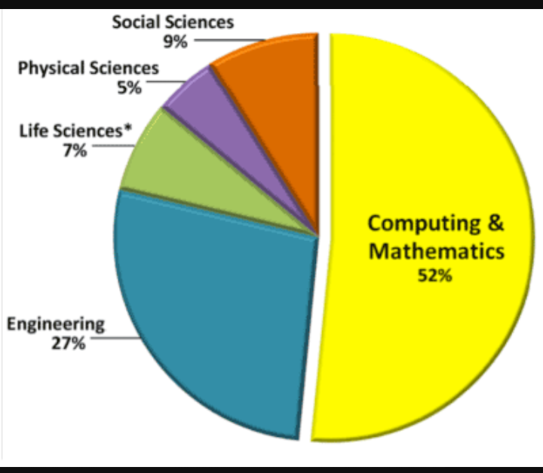
Trend of Opting Higher Education in Computers as compared to Other streams

Slide 35
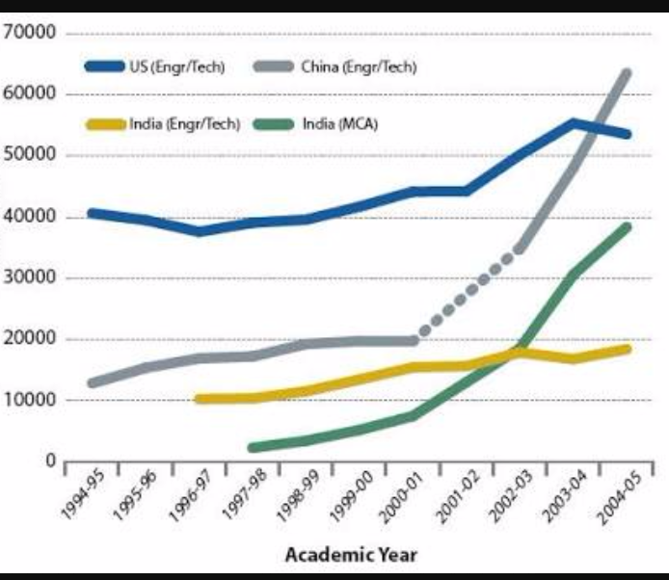
Higher Education Statistics In India

Slide 36
Jobs Opportunities After Computer Graduation

Slide 37
Jobs Opportunities After Computer Graduation
Job in Government
Sector e.g. : Banking, Dairy ,Farming
Industries,CDS etc
Jobs in Private Sector
e.g. : Software Company, Web Designing

Slide 38
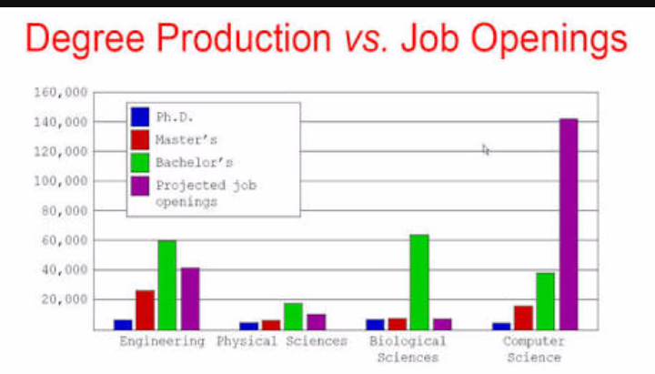


Slide 39
Job in Government Sector
Job | Eligibility | Website
IT Officer in Banking | Masters in Computer Science/IT/MCA or equivalent | www.ibps.in
Clerk/PO | Graduate from any recognized institute | www.ibps.in https://www.sbi.co.in/ https://www.rbi.org.in/
IT Officer/ Computer engineer in Railway | Bachelors in Computers/IT or Masters in Computer Science/IT/MCA or equivalent | www.rrb.gov.in
SSC | Graduation from recognized institute | www.ssc.nic.in
IAS/IPS/IFS Officer | Graduation form recognized institute | www.upsc.gov.in

Slide 40
Job | Eligibility | Website
Junior Engineer in Electricity department | Bachelors in Computers/IT or Masters in Computer Science/IT/MCA or equivalent | http://www.uhbvn.com/
CID/CBI/Intelligence officers in Intelligence Bureau | Graduation from recognized institute | www.mha.nic.in
Regional Government Jobs | ITI / Diploma/ Graduate in specific discipline | Check google for Regional government site
CDS Officer | Graduate from recognized institute with marks >60% | www.upsc.nic.in
Teaching | Masters + HTET for school level NET for college level | www.hssc.gov.in

Slide 41
Job in Private Sector

Slide 42
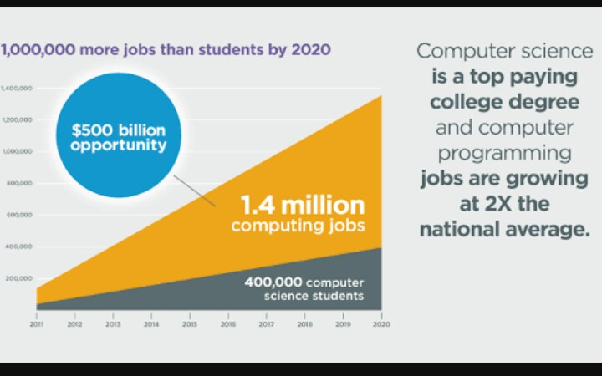

Slide 43
Doing job after graduation is trending now in India and having a great scope in brighter career.
Around Lakhs vacancies are get published each year
Top IT companies hire computer graduates and encourage them to pursue their Post Graduation (MS degree from BITS Pilani or Vellore Institute of technology.

Slide 44
Some of the popular job fields are listed below
Software Development
Software Testing Engineer
Technical Support engineer
IT- BPO
Web Designing
Content writing
2D/3D Animation and Graphic Designer
Software Sales Engineer
Network Engineer and Server Administrator

Slide 45
Jobs Details
Jobs | Eligibility | Selection Crieteria | Aprrox. Salary Package
Software Developer | Graduation | Depends upon company’s policy | 2,00,000 to 12,35,000
Software Testing Engineer | --do-- | --do-- | 1,44,000 to 7,50,000
Technical Support engineer | --do-- | --do-- | 1,80,000 to 9,45,000
IT- BPO | --do-- | --do-- | 2,00,000 to 6,00,000
Web Designing | --do-- | --do-- | 1,80,000 to 10,00,000

Slide 46
Jobs | Eligibility | Selection Crieteria | Aprrox. Salary Package
Content writing | --do-- | --do-- | 1,44,000 to 7,50,000
2D/3D Animation and Graphic Designer | --do-- | --do-- | 2,00,000 to 8,00,000
Software Sales Engineer | --do-- | --do-- | 1,20,000 to 12,00,000
Network Engineer and Server Administrator | --do-- | --do-- | 1,80,000 to 8,60,000
Android App Developer | --do-- | --do-- | 1,50,000 to 8,50,000

Slide 47
Create your own Software Company

Slide 48
Steps to create your software company
Gaining an Education and Experience
  Develop programming and business expertise
  Work for a software company in a management capacity
  Generate a product idea
Preparing to Launch Your Product
  Protect your product idea
  Create a business plan
  Determine the legal structure of your business
  Register your business name with your state government, if necessary

Slide 49
  Determine if you need to get a tax identification number for your business
  Become knowledgeable about licensing, taxes and insurance
  Raise funds for your software company
  Purchase the necessary equipment and applications
  Hire manpower
  Create a development time line for the product
Testing and Marketing the Product
  Test your software product after the development phase
  Gather a team of beta testers
  Market your product
  Determine the price point for your product

Slide 50
Student of S.D College Placed In Different Companies After Graduation
Student Name | Company Name | Post
Preetika, 2006-09 | --do-- | --do--
Isha Mehra, 2006-09 | --do-- | --do--
Mandeep Kaur, 2007-10 | SD College, Ambala | Assistant Professor
Narender Kumar, 2007-10 | HDFC Std. Life Insurance | --do--
Kapil Rana, 2008-11 | Government | Army Officer
Puneet, 2008-11 | Government | Navel Officer
Abhimanyu, 2008-11 | Wipro | --do--
Manisha Chauhan, 2008-11 | --do-- | --do--
Bhawna Verma, 2008-11 | --do-- | --do--
Shivang Garg, 2009-12 | Decimal Technologies, Noida | IOS application developer

Slide 51
Student Name | Company Name | Post
Gurdeep, 2009-12 | Government | Sarpanch
Chandan, 2009-2012 | Information & Network Security | Network Administrator
Sushil Sharma, 2010-13 | Inventom Technology | System Engineer
Vibhuti Goyal, 2010-13 | Biz 2 Credit Pvt. Ltd. | DBA
Sanjana, 2011-14 | Wipro | Software Developer
Monishka, 2011-14 | --do-- | --do--
Aakanksha Uppal, 2011-14 | --do-- | --do--
Chetan, 2012-15 | Infosys | --do--
Aashish, 2012-15 | Bit Kanvas Pvt. Ltd. | Owner
Ankit Kumara, 2013-16 | IBM | Technical Support
Anmol Sharma, 2013-16 | HDFC | Technical Support
AnkitaChauhan, 2013-16 | Wipro | --do--
Shivani, 2013-16 | TBSS | --do--

Slide 52
Student of S.D College who opted for Higher studies
Student Name | Institute Name
Vaishali Gupta, 2008-11 | Punjab University, Chandigarh
Shweta, 2009-12 | CGC Landran
Yashmi Dhiman, 2011-14 | Hyderabad Central University
Manish, 2011-14 | Chitkara University
Neha Jamal, 2012-15 | Punjabi University, Patiala
Tanvi, 2013-16 | Thapar University
Ramandeep, 2013-16 | --do--

Slide 53


